Slide 1
Indian Society – Caste
Module-4 Part I

Slide 2
Caste
“Caste is a collection of families, bearing a common name, claiming a common descent, from a mythical ancestor, human or divine, professing to follow the same hereditary calling and regarded as single homogenous community” Herbert Risley
“chopping off of the population into fixed and definite units, each one prevented from fusing into another through the custom of endogamy.” B.R Ambedkar
“Caste is a closed class” D.N Majumdar
Cont..

Slide 3
“Any attempt to define caste is bound to fail because of the complexity of the phenomenon.” Ghurye
M.N Srinivas sees caste as a segmentary system. According to him every caste is divided into sub castes which are the units of endogamy whose members follow a common occupation, social and ritual life and common culture and whose members are governed by the same authoritative body viz the panchayat.
“Caste groups are united into a system through two principles
of segregation and hierarchy.” F.G Bailey

Slide 4
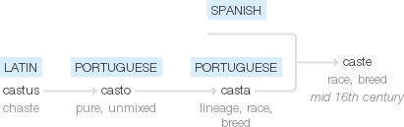
Origin
Indo-European-speaking people from West Eurasia entered India from the
Northwest and diffused throughout the subcontinent.
They purportedly admixed with or displaced indigenous Dravidic-speaking populations. Subsequently they may have established the Hindu caste system and placed themselves primarily in castes of higher rank
The word caste also signifies race or kind. The Sanskrit word for caste is Varna that means color. The caste system in India is an important part of ancient Hindu tradition and dates back to 1200 BCE

Slide 5
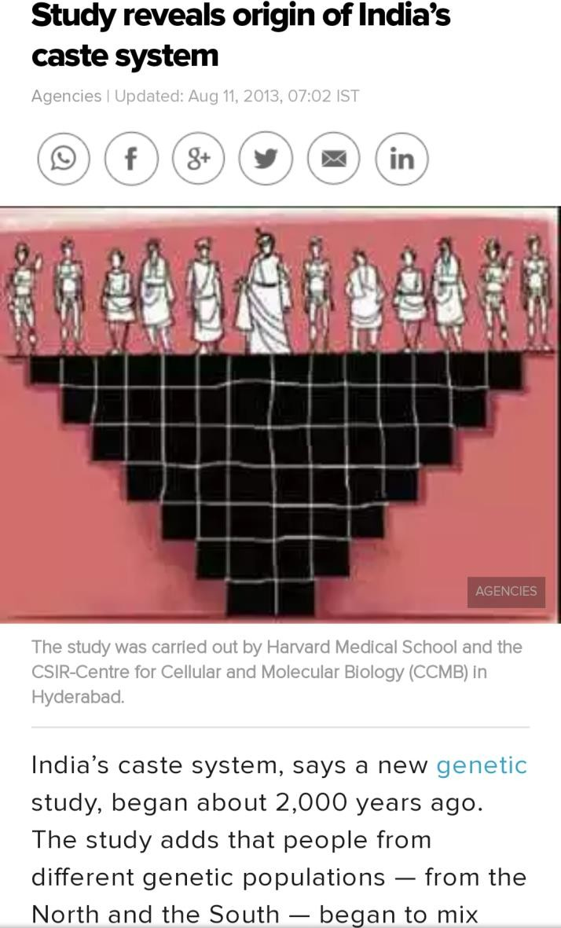
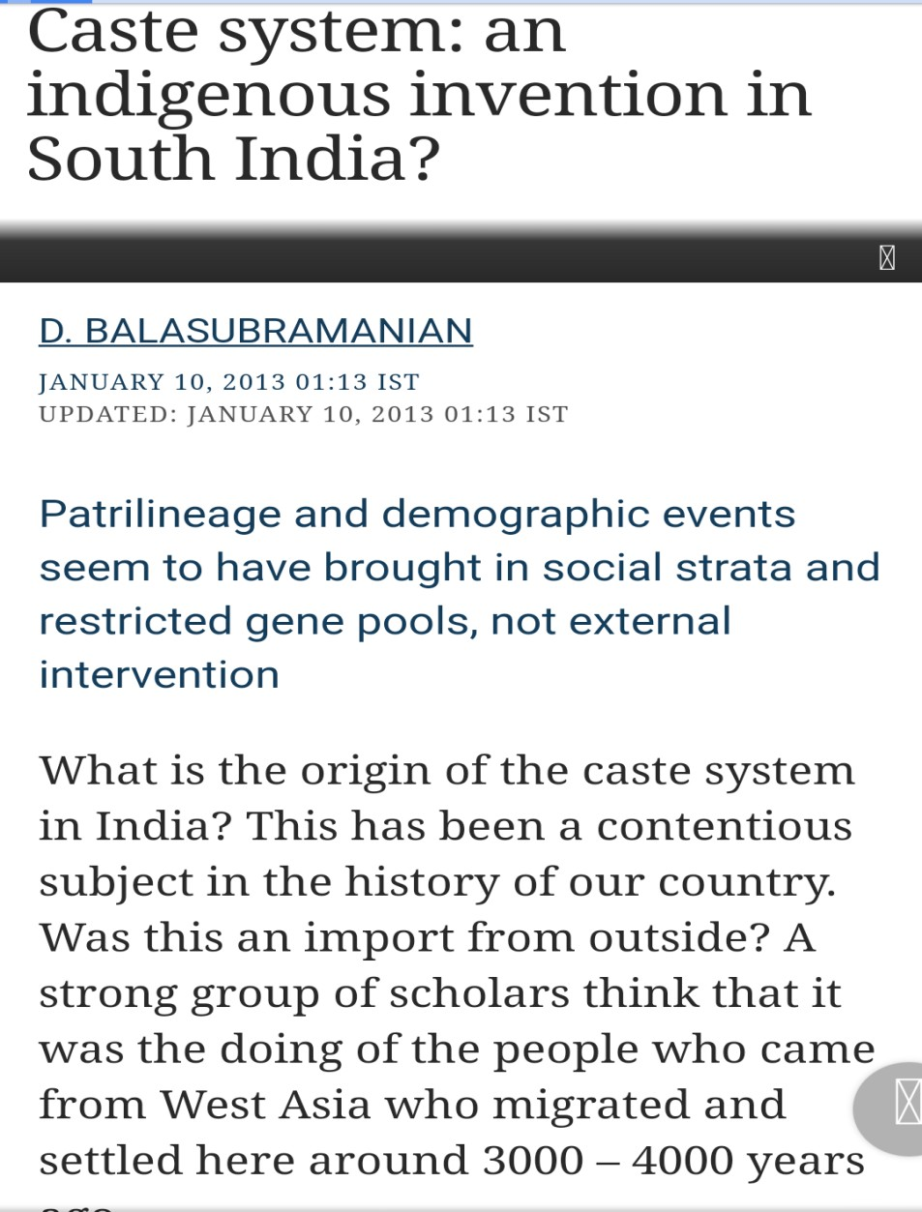
Study on origin of caste

Slide 6
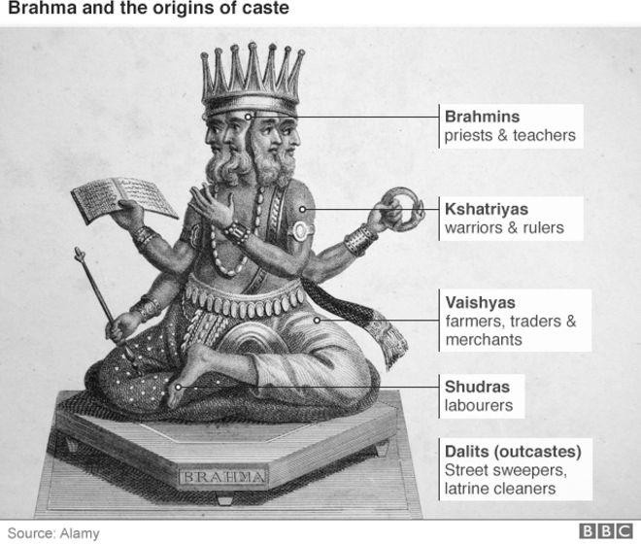
Caste system in India
The four caste groups:
Brahmins: Religious authority
Kshatriyas: military ruler and landlord caste
Vaishyas: traders and farmers
Shudras: the servants and labour

Slide 7
CHARACTERISTICS OF CASTE SYSTEM
Caste is Innate
Hereditary
Hierarchy
Restriction on Food Habits
Caste is Endogamous
Hierarchical Social Structure
Occupation is Fixed
Concept of purity and pollution

Slide 8
Hereditary
An individual’s caste is determined by the caste of the family he is born in. It is generally hereditary. One’s caste is unalterable no matter what his/her social position is. One inherits the membership of a caste by his/her birth.
Hierarchy: Hierarchy refers to the ladder of command where different castes are positioned on the upper and lower strata as per their positioning in the caste ladder. It shows who is considered superior and who is considered to be inferior.
In this ladder, Brahmins occupy the superior position and the untouchables occupy the inferior one.In between the Brahmins and untouchables are the intermediate castes.
Endogamy: This refers to the rule where individuals are supposed to marry a person belonging to one’s caste.Marriage outside one’s caste is not preferable. Those who violate the rule are ostracised or lose their caste status. However, these rules are gradually changing.
Concept of purity and pollutionA very important feature of the caste system is the concept of purity and pollution. People and practices of lower castes are considered to be impure and it is believed that the lower caste’s touch, food and shadow may pollute a higher caste person’s body, food or image.
Even certain foods are not supposed to be consumed by higher caste members as they are considered to be impure. These include consumption of non-vegetarian food, liquor etc.However, with growing urbanisation and the spread of western education, such social patterns are changing.

Slide 9
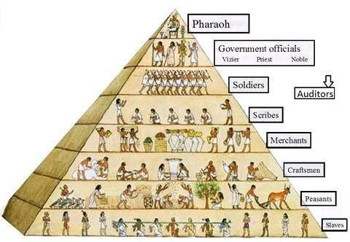
Order of people as per the caste occupation

Slide 10
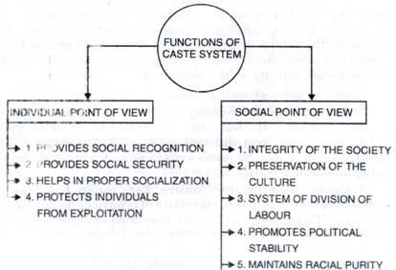
Functions and Dyfnctions of caste system
Caste has been described as the fundamental social institution
Minimises economic competition by determining the occupation of various caste groups.
Restricting and limiting in choosing spouse, rules of endogamy are traditionally very strict and violations of rules are taken seriously.
The economic basis of the case system is Jajmani system. The patorns (Jajmans) or higher castes who control land ownership exchange the land produce against the services provided by other castes.
Caste also seen
as social and
for its
psychological resources
members, Sense of solidarity.
Sources: http://www.yourarticlelibrary.com/essay/caste-system-in-india-functions-and-dis-functions-of-caste-system/47089

Slide 11
Dysfunctions of caste system
Create social obstacles: Caste system divides society into- many groups. Each group is attached to rigid social norms and values, because of which normal interaction among the categories is not possible.
Slow social change: All the caste groups have to follow certain fixed and rigid rules and regulations. The basis of these rules and regulation is the principle of ‘Purity and Pollution’. One has to conform the traditional norms and values to maintain the principle.
Hinders economic progress: Unequal distribution of wealth, low caste people are allotted occupations which give them low income, denies social and occupational mobility.

Slide 12
Impact of caste system on social and economic status of society:
Hinders Social Progress: Caste system poses a hindrance to social progress because it does not allow changes to be easily introduced into the society. Under the caste system, the individual is not free as he needs to conform to the age-old customs of his caste. This rigidity of the system has hindered social progress in our society.
Stifles Economic Progress: As occupations are determined by status, the worker is denied his freedom to choose an occupation of his liking. This leads to immobility and inefficiency of labour and thereby stifles economic progress.
Leads to Political Disunity: In the caste system, an individual is required to be more loyal to his caste than to any other group. Hence, it fosters casteism rather than nationalism among the people.

Slide 13
Perpetuates Social Inequalities: Caste system has served as an instrument in the hands of the upper castes to maintain their own privileged position in society. It has led to the despotism of the upper castes and created permanent feelings of inferiority and insecurity in the minds of lower caste people.
Imposes Hardships on Women: In many cases, the caste system has proved to be exploitative for women. Under caste system, a caste wishing to raise its status in the caste hierarchy should follow certain customs like child marriage, prohibition of widow remarriages and seclusion of women, all of which lead to hardships for them and degradation of their status in society.
.

Slide 14
Untouchability
Discrimination
Inferior status of women
Fall of Hinduism
Religious conversion
It hampered national development:
It undermined the ability and aspirations of the people

Slide 15
Political conflict:
conflict. Involvement
Caste
system also breeds political
of caste in democratic system
creates conflicting situation in the political field. Political parties are using caste as their means to get vote.
Low status of women: Prohibition of widow remarriage, women education, child marriage.
Untouchability: Only caste system pushed people towards suffering of a particular section of the society who are untouchables. They are suppressed and exploited by the high caste groups.

Slide 16
Social change in modern India
Caste mobility: Sanskritization and Brahminization
Changes in ritual and economic aspect of caste: Urbanization and westernization
Changes in economic aspect of caste: Industrialization
Secularization and Democratization

Slide 17
Next class discussion on
CAUSES FOR THE CHANGES IN CASTE SYSTEM

